Slide 1


Strawberry Greenhouse
Monitoring System
Maroua LADDADA & Issa SIDIBE
Supervisor: Thomas DARGENT
Academic year: 2023/2024

Slide 2
OUTLINE
CHAPTER 1 - Project Background
Introduction
IoT in Agriculture
Benefits of Iot in Agriculture
Project’s idea
CHAPTER 2 - Hardware components
CHAPTER 3 - Design & Fabrication
Programmation
Connection to Thingsboard
PCB Realisation
CONCLUSION

Slide 3

CHAPTER 1
Project Baground

Slide 4
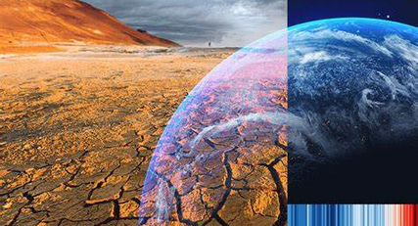
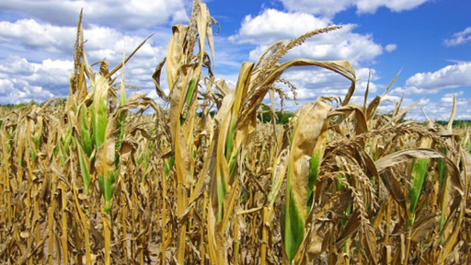
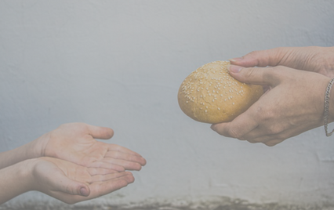
Introduction
The world’s climate is changing rapidly, and this will continue to do so in the future which means new risks for food and agriculture.
https://th.bing.com/th/id/OIP.sA2Y7f1OFhWEEG5DrdPpIgAAAA?rs=1&pid=ImgDetMain
4
https://agrointel.ro/wp-content/uploads/2022/08/seceta-agricultura-porumb.jpg

Slide 5
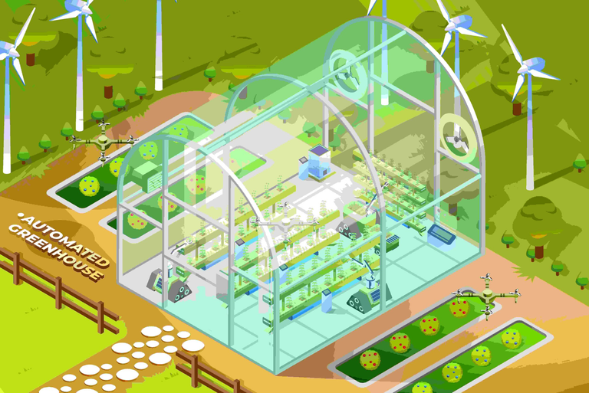
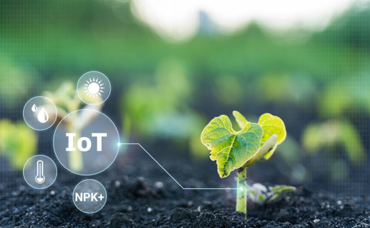
IoT in Agriculture
In the agricultural world, IOT solutions take the form of sensors connected to the Internet to collect environmental and mechanical measurements.
5
https://s3-us-west-2.amazonaws.com/aa.techdemand.io/wp-content/uploads/2022/02/14184734/IoT-in-Agriculture-1024x631.jpg

Slide 6
Benefits of IOT in Agriculture
Increase productivity and the quality of the product.
Increases profits / incomes and reduces significantly the costs
Having access promptly to exact accurate data helps in increasing the efficiency level in the use of water , pesticides, and fertilizers amounts managements.
6

Slide 7
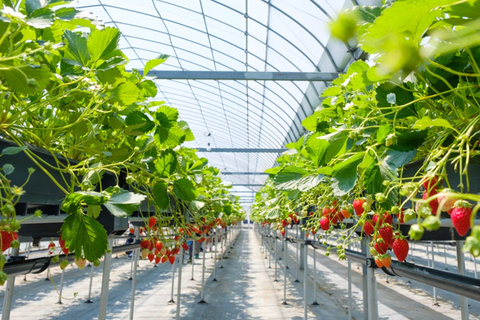
Project’s idea
1. Temperature Control
- Maintaining optimal temperature for growth (15-25°C)
2. Humidity Management
- Need for high humidity (60-80%) for optimal growth
3. Light Requirements
- Sufficient light intensity and duration (10-14 hours daily)
4. Pest and Disease Control
- Monitoring and managing common pests (e.g., spider mites)
5. Nutrient Supply
- Ensuring balanced nutrient supply through soil or hydroponics
6. Watering Systems
- Efficient irrigation systems (drip irrigation, hydroponics)
7

Slide 8
CHAPTER 2
Hardware Component

Slide 9
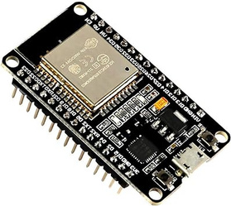
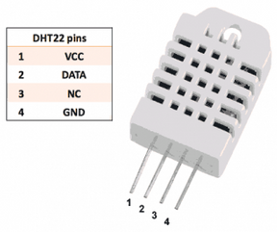
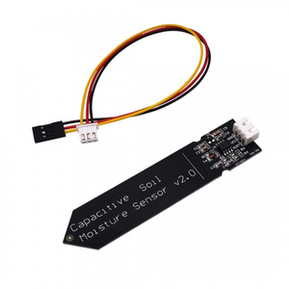
Hardware Components
Our prject depends on IOT technology using ESP32 as a microcontroller and a set of sensors.
ESP 32 [1]
DHT 22 [2]
SoiL Moisture Sensor [3]
It is a microcontroller board That receives inputs from many sensors and turn it into outputs to control a system.
It mesures temperature and humidity.
It mesures the scale of the water in the soil
[1] https://www.orient.lv/wp-content/uploads/2020/11/v_nodemcu_esp_wroom32_bt_wifi-600x600.jpg
9
[2] http://akademia.nettigo.pl/dht22/
[3] https://th.bing.com/th/id/OIP.gjFeVvS2yNaeRqQbCzaVpgHaHa?w=600&h=600&rs=1&pid=ImgDetMain

Slide 10
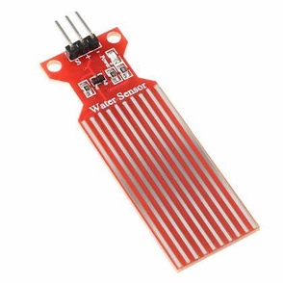
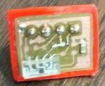
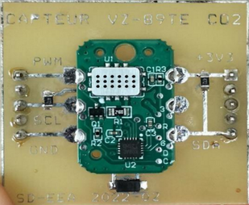
Hardware Components
Water Level Sensor [1]
Light Sensor
Carbone Dioxyde Sensor
It measures the water level
It is used to detect the light radiation
It mesures the amount of CO2 in the desired area.
10
[1] https://th.bing.com/th/id/OIP._IW9W86BkuvLh5mhcAAHBQAAAA?rs=1&pid=ImgDetMain

Slide 11
CHAPTER 3
Design & Fabrication

Slide 12

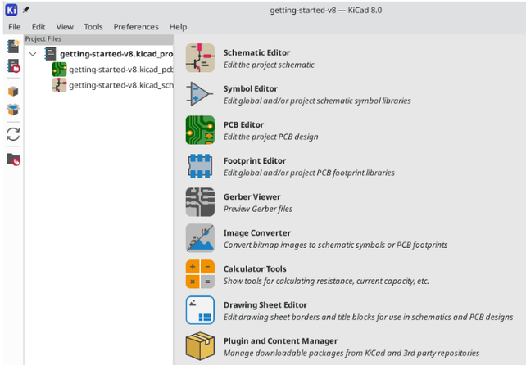
KiCad Overwiew
An open-source software suite for electronic design automation (EDA).
Key Features:
Schematic Capture: Create and edit electronic circuit diagrams.
PCB Editor: Design and layout printed circuit boards (PCBs) with multiple layers.
3D Viewer: Visualize PCB designs in 3D for better understanding and error checking.
Component Libraries: Extensive libraries for components, footprints, and symbols.
12

Slide 13
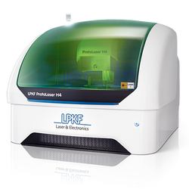
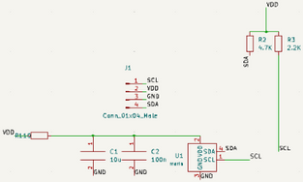
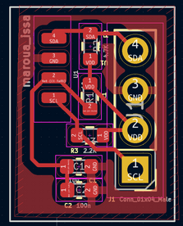
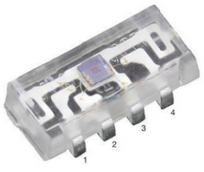
Light Sensor design and Fabrication
Using KiCad to do design the PCB to put the sensor
Fabrication of the PCB using PhotoLaser machine
13
https://fr.rs-online.com/web/p/capteurs-de-couleurs-et-lumieres/1226791

Slide 14
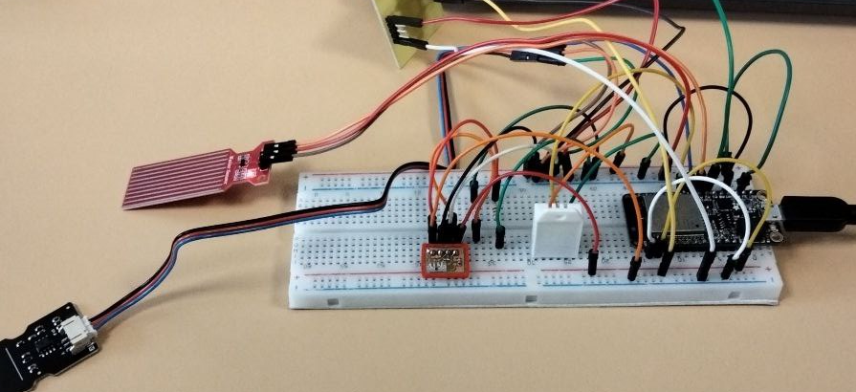
Wiring
Using breadboard to connect all the sensors to ESP32
14

Slide 15
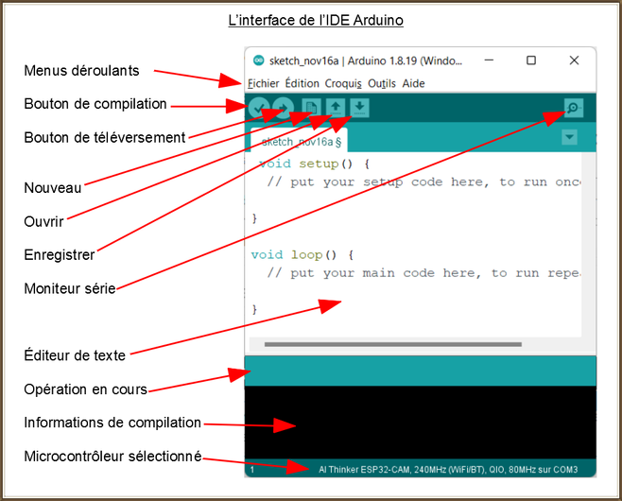
Programmation
Arduino IDE
Libraries definitions
WiFi and ThingsBoard Configuration
Pin Definitions
Setup Function:
Initializes serial communication; Sets up sensors; Connects to WiFi and ThingsBoard.
Loop Function:
Reads sensor data:Temperature and humidity from DHT22; CO2 levels, water level, light intensity, and soil moisture.
15

Slide 16
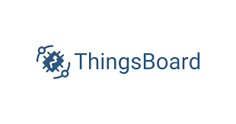
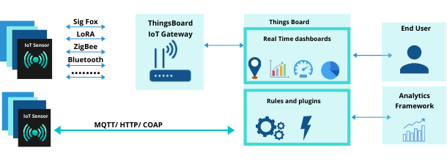
Connection with Thingsboard
Thingsboard principles
https://thingsboard.io/
16

Slide 17
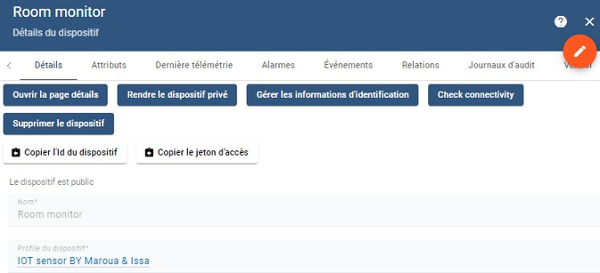
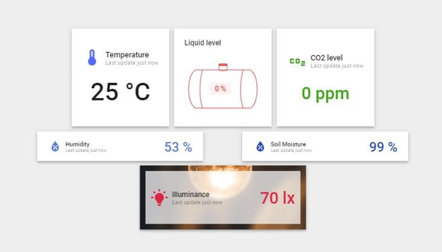
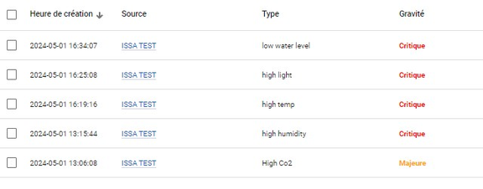
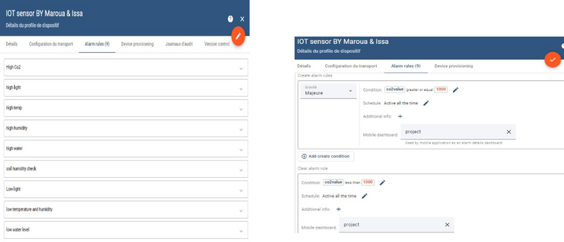
Device definition
User dashboard
We create a device which will be associated to the hardware to show the sensors result
Alarms setup
In the alarm rules, we use the device profil and write the conditions that must be respected
Real time data widgets
Alarms widget
17

Slide 18
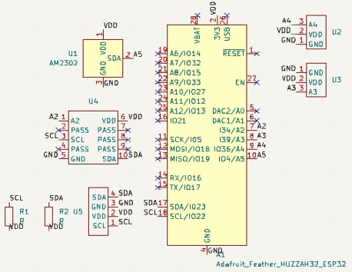
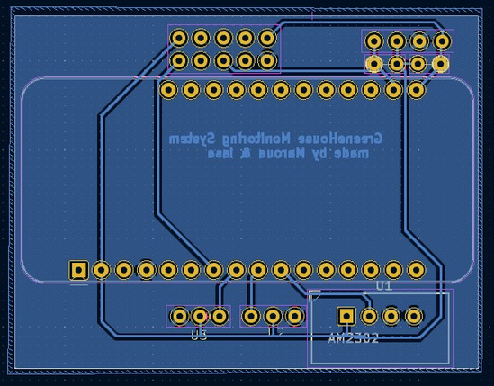
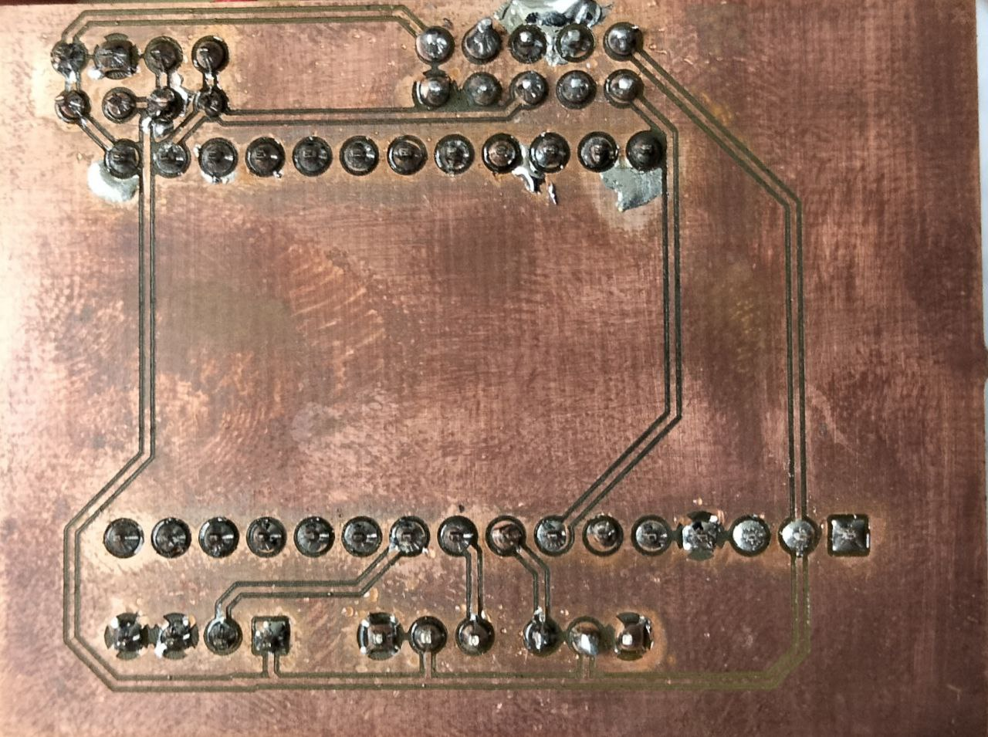
The PCB of the project
From Design to Fabrication
51 cm
39 cm
Electronic schematic and PCB design
Fabricated PCB
18

Slide 19
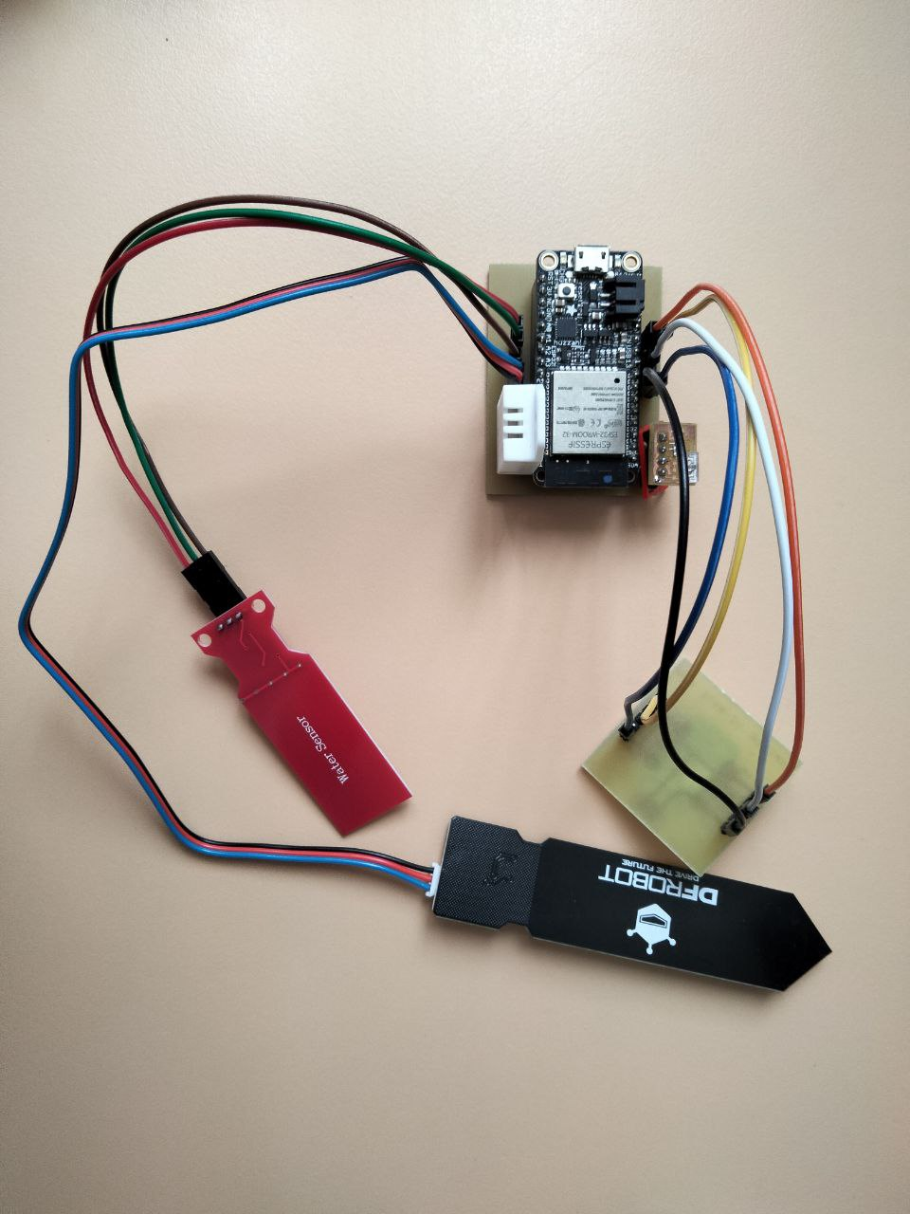
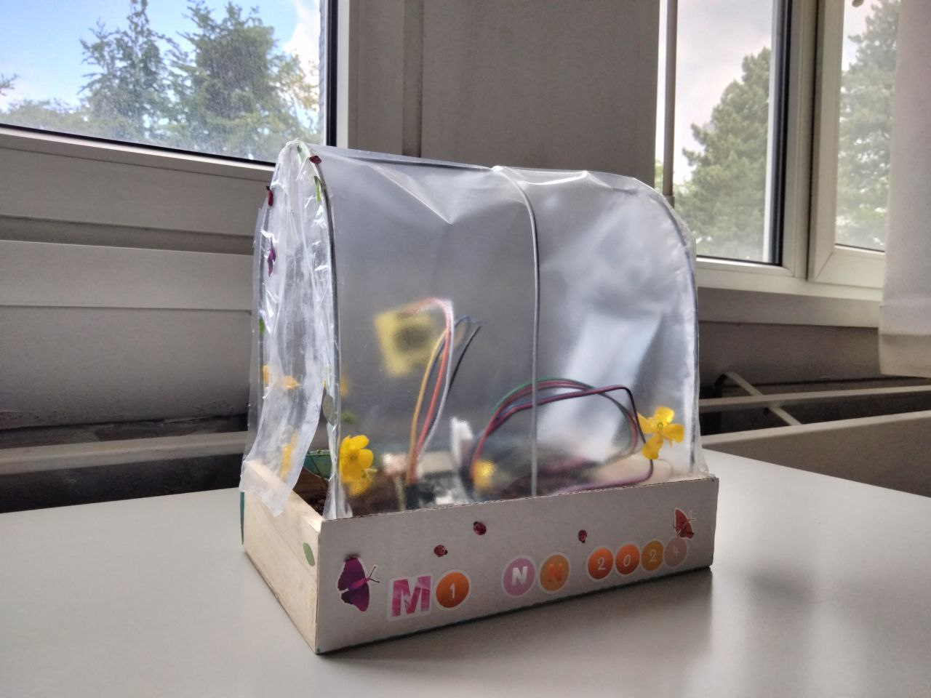
Final Project
19

Slide 20

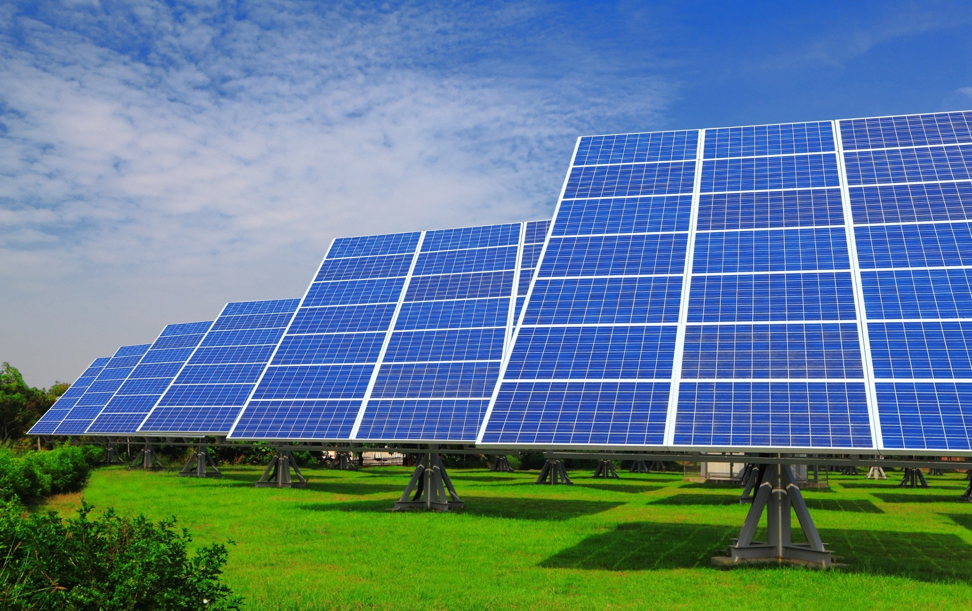
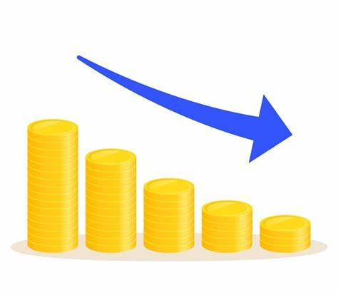

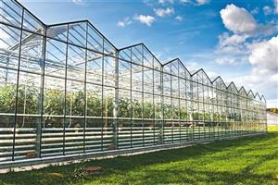
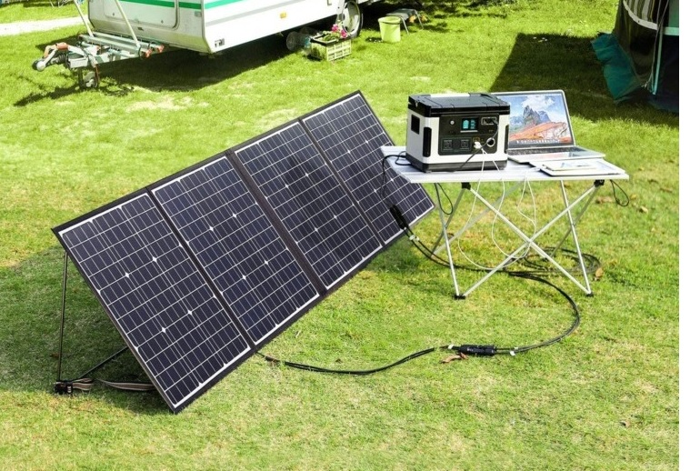
Conclusion and Perspectibves
With IOT SYSTEM WE CAN:
- SAVE THE WORLD
- INCREASE PRODUCTION PERFORMANCE
- HAVE A REAL TIME CONTROL
20

